Slide 1


Generation SG JDE05 Interim Project
By
Daniel, Pin Pin, Pin Yeen, Shawn
DPPS

Slide 2

Problem Statement
In order to save on electricity bills, search for a resale flat at the coolest town in Singapore within a specified budget

Slide 3

Data needed for analysis
Air temperature
Humidity
Resale HDB transaction prices

Slide 4

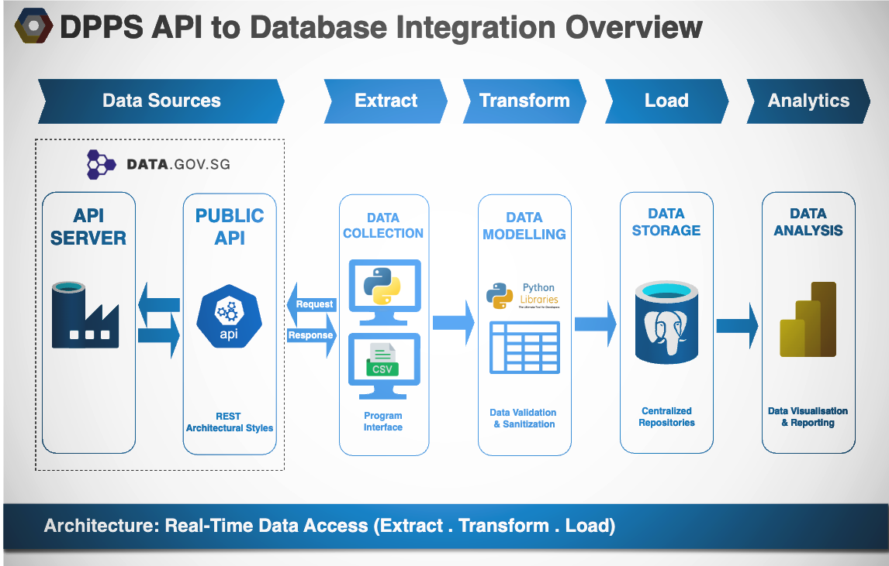

Slide 5
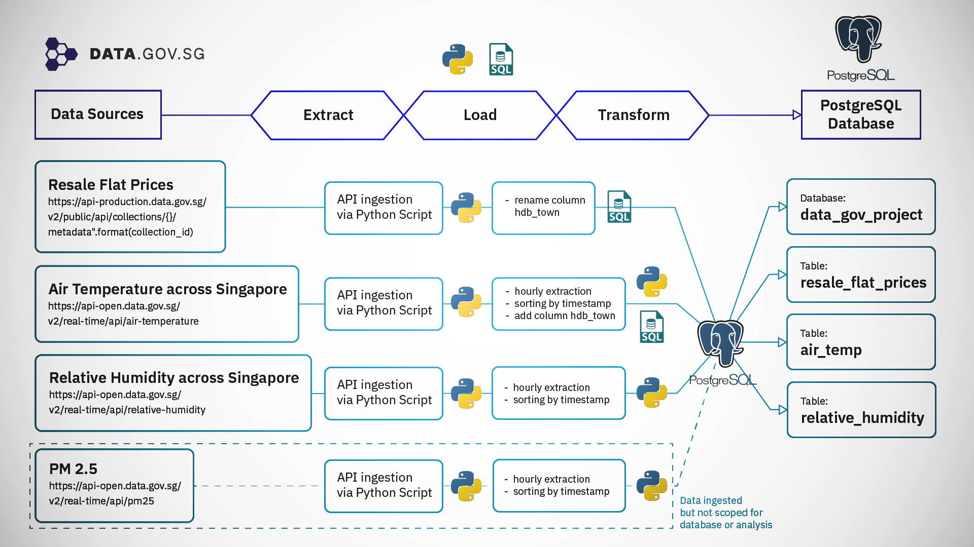

Slide 6



Extract
NEA API https://api.data.gov.sg/v1/environment/air-temperature https://api-open.data.gov.sg/v2/real-time/api/relative-humidity
HDB CSV https://api-production.data.gov.sg/v2/public/api/datasets
Air temperature readings
Humidity readings
HDB transaction prices
DATA.GOV.SG

Slide 7
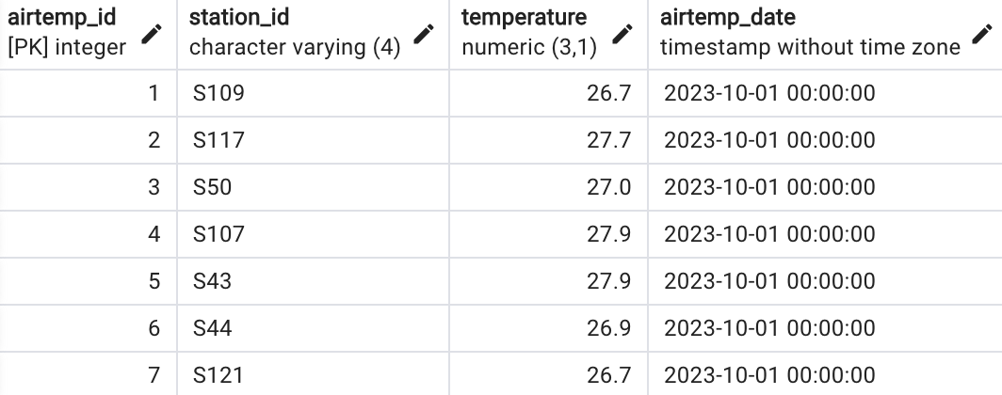
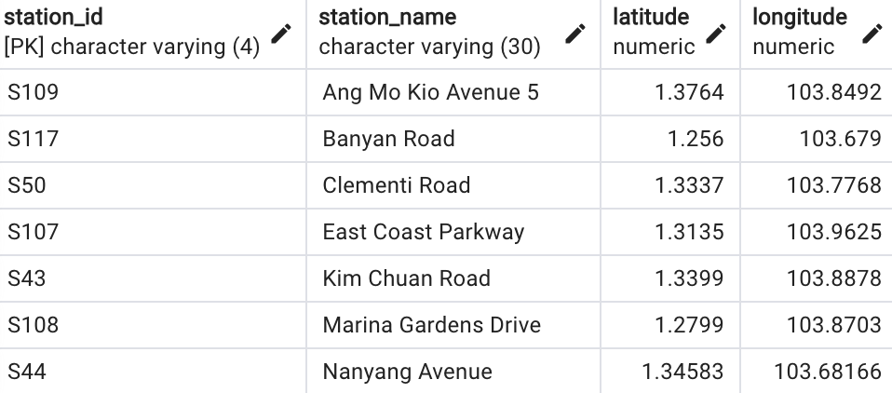
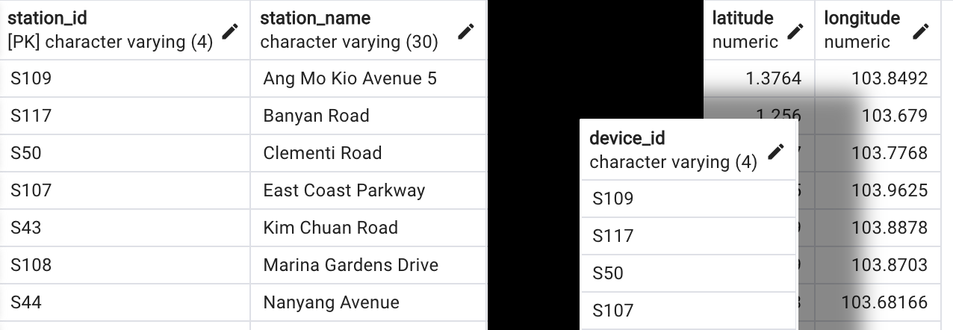
Transform
Data normalisation to reduce redundancy
Split JSON data to different data frames due to repetition
Drop unnecessary columns
Filter out outliers or incomplete data

Slide 8

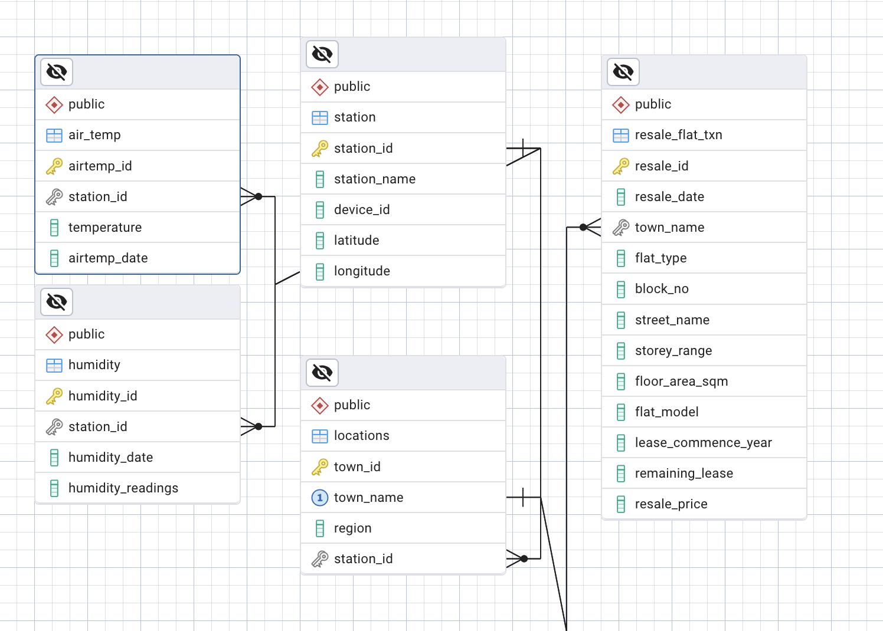
Load. PLACEHOLDER SLIDE

